Slide 1



FAKE NEWS
DETECTION
KAVYA M
MARGRET JAISON
NIVEA GIGEN
PARVATHY SANTHOSH

Slide 2

INTRODUCTION
With the mobile Internet development, e-health has become increasingly connected with people’s daily life .However, health information on internet is severely corrupted by misinformation , especially for the aged .It is necessary to analyze the characteristics of health-related misinformation on Internet and to design automated detection tools. Here we focus on analyzing common characteristics of reliable and unreliable health-related information on online social media and exploring possible detection method using machine learning

Slide 3
LITERATURE REVIEW
“Syntactic stylometry for deception detection" by Feng, song and Banerjee, Ritwik and Choi, Yejin
the 50th Annual Meeting of the Association for Computational Linguistics : Short Papers ­ Volume 2, ACL ’12, (Stroudsburg, PA,USA), pp. 171– 175, Association for Computational Linguistics, 2012.
They focus on language pattern followed by deceptors in their language.
They consider verbal aspect such as frequencies pattern of pronoun, conjunction ,negative emotion ,word usage etc.
They uses shallow and deep syntax analysis.

Slide 4
"Automatic Deception Detection For Detecting Fake News" by Conroy, Niall J and Rubin
The 78th ASIS&T Annual Meeting Information Science with Impact: Research in and for the CommunityResearch in and for the Community, ASIST’15, (Silver Springs, MD, USA), pp. 82:1–82:4, American Society for Information Science, 2015.
They proposed two method
* Linguistic approach which include various syntactical and sematic features used in deception detection.
* Network approach which depends on querying existing knowledge network or publicly available structured data.

Slide 5
“Automatic Detection Of Fake News,” by v. Pérez­rosas, b. Kleinberg, a. Lefevre, and r. Mihalcea
vol. abs/1708.07104, 2017.
This model achieved accuracies which are similar to the human ability to spot fake news.
They focused on the automatic identification of fake content in the online news.
They come up with idea of using several linguistic features like n-gram, Syntax , readability, punctuations etc.

Slide 6
“Evaluating Machine Learning Algorithms For Fake News Detection” by Shlok Gilda
2017 IEEE 15th Student Conference on Research and Development
It is the first time idea of applying NLP concept to fake news detection was used.
He used techniques like tf-idf of bigram and PCFG.
He tested the database on multiple classification algorithms like Random Forest, Gradient Boosting, SVM, Stochastic Gradient Descent etc.
He come up with Stochastic Gradient Descent model having an accuracy of 77.2%.

Slide 7


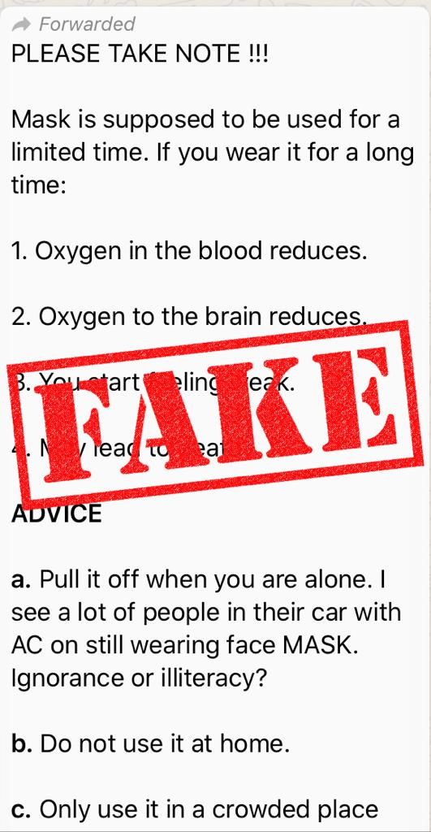




Slide 8

OBJECTIVE
The main objectives of the project are:
To build a model to accurately classify a piece of news as REAL or FAKE.
To get high accuracy to determine a news is fake or true.

Slide 9
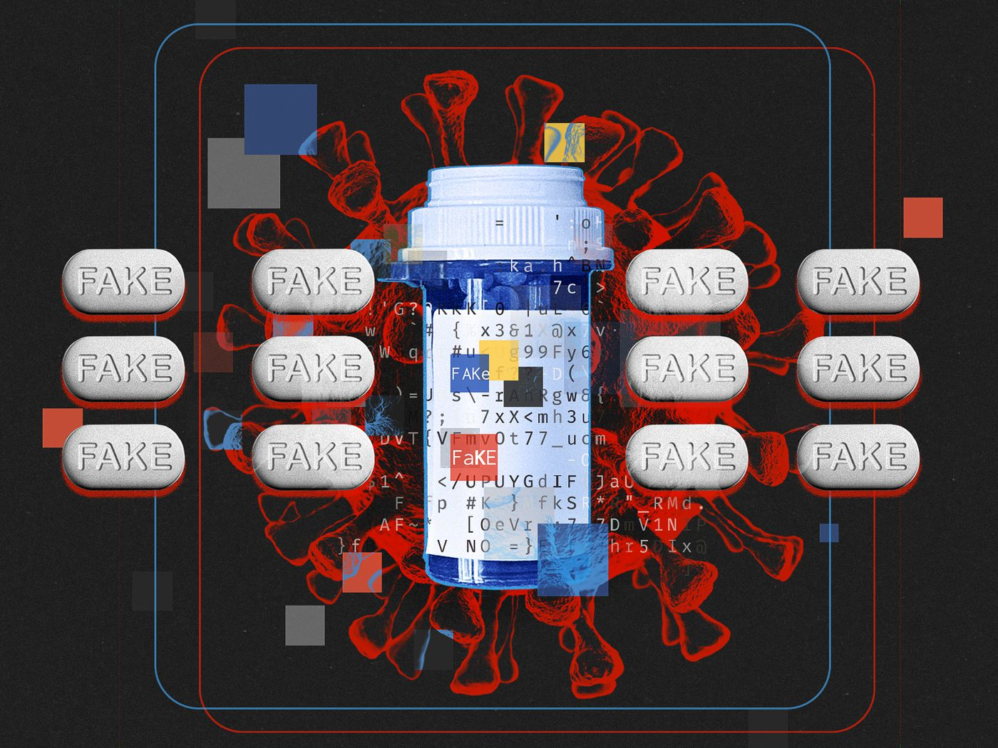
SIGNIFICANCE
Misinformation and falsehood of health news in social media constitute a potential threat to the public health.
Necessary for the people to distinguish the fake and real news that comes in social media.
Due to the fake news there may be a chance of serious violence which may leads to lack of peace in the society and sometimes leads to the negative growth of the country

Slide 10




Mapping to United Nations Sustainable Development Goals

Slide 11

FUNCTIONALITY
Main functions of our proposed system are:
Allows user to input news link.
Extract all the corresponding reviews.
Allow user to produce veracity of the input news.
There is a view button in GUI. if user press it ,it displays whether the news is fake or real.

Slide 12
User & Developer characteristics:
Users have access to the system & developers have access to the data.
System has simple GUI so no need of additional user documentation.
User interface has the provision to input a news link from either Facebook or twitter. It allow the user to know whether the news is real or fake.
Developers use the data & perform training & modelling

Slide 13

REQUIREMENTS
HARDWARE USED
intel core i5 or above
RAM:8GB
operation speed:2.0GHZ or above
hard disk: 30GB or more.

Slide 14
REQUIREMENTS SOFTWARE USED
Jupyter Notebook: The JupyterNotebook is an open source web application that allows you to create and share documents that contains live code, equations, visualization and narrative text. Uses include: data cleaning, transformation, numerical modeling, statistical modeling, data visualization, machine learning and much more.
Flask: It is a web frame that provides various tools, libraries and technology that allows us to build a web application

Slide 15

LANGUAGE USED
Python 3.6

Slide 16

TECHNIQUE USED
NLP
Natural Language Processing
Machine Learning

Slide 17




LIBRARIES USED
Pandas: For reading csv files
converting it to data frame.
Numpy: For array computation.
Sklearn: scikit learn for shuffling
data performing cross validation,
performance metrics
Matplotlibs: For plotting graphs.

Slide 18
nltk (Natural Language Toolkit): Suite of libraries and programs for symbolic and statistical natural language processing in python
Pickle : This module saves a program’s state data to disk so that it can carry on from where it left off when restarted, thus saving time
Scrapy : It is a free and open source web-crawling framework written in python

Slide 19
DATASET USED
A data set is a collection of numbers or values that relate to a particular subject.
In the project we will use the required attributes of Kaggle datasets to train our model. The dataset used in project are:
https://github.com/cuilimeng/CoAID
https://github.com/bigheiniu/meta-coronavirus-dataset
https://www.kaggle.com/tags/healthcare

Slide 20
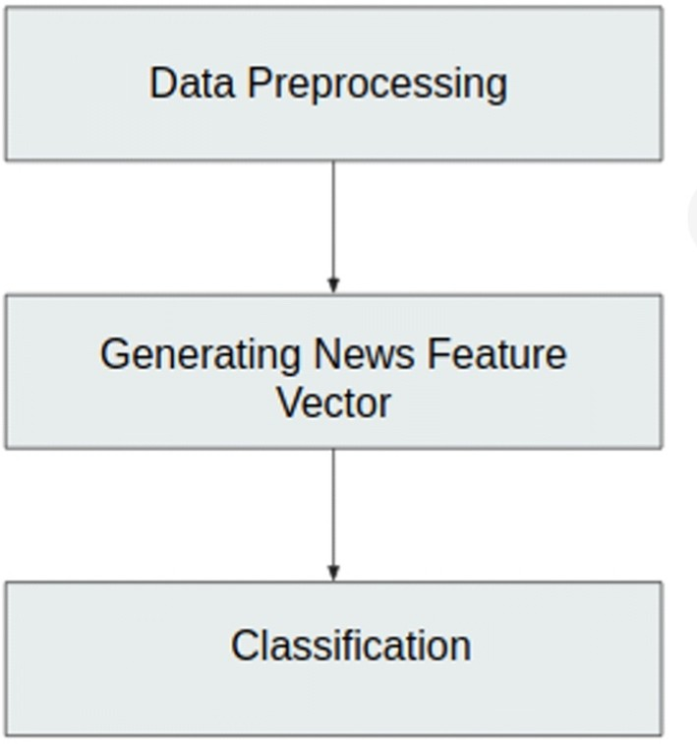
METHODOLOGY
The various approaches used in this project are:
Data Preprocessing
Generating News Feature Vector
Review Extraction Module
Classification

Slide 21
DATA PREPROCESSING
Data preprocessing is done to convert the raw data into a required format.
Various methods used are data integration, data transformation ,data cleaning & data reduction.
In this project ,the datasets are collected from different resources which have different formats & attributes.
So we convert data into required format with required attributes which are used to train our model

Slide 22
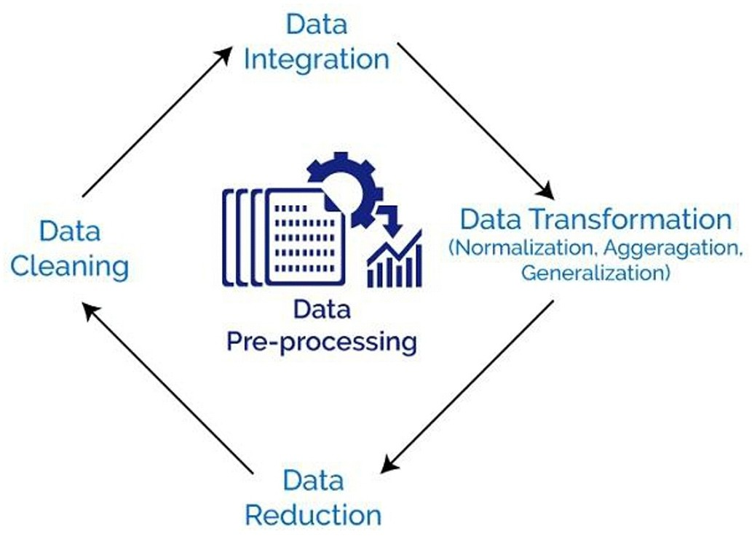
DATA PREPROCESSING

Slide 23
GENERATING NEWS FEATURE VECTOR
The most important part of detecting if a given news is fake or not is to convert the news article into a news vector which contains the important features which are used to determine the nature of the news.
Some of the methods are:
BAG OF WORDS
Bag of words is a way of representing text in a format which can be easily processed by the machine learning algorithms. BoW is one the ways of extracting features from text. In this type of text representation, majorly 2 things are involved:
Vocabulary of known words
Measure of presence of known words

Slide 24
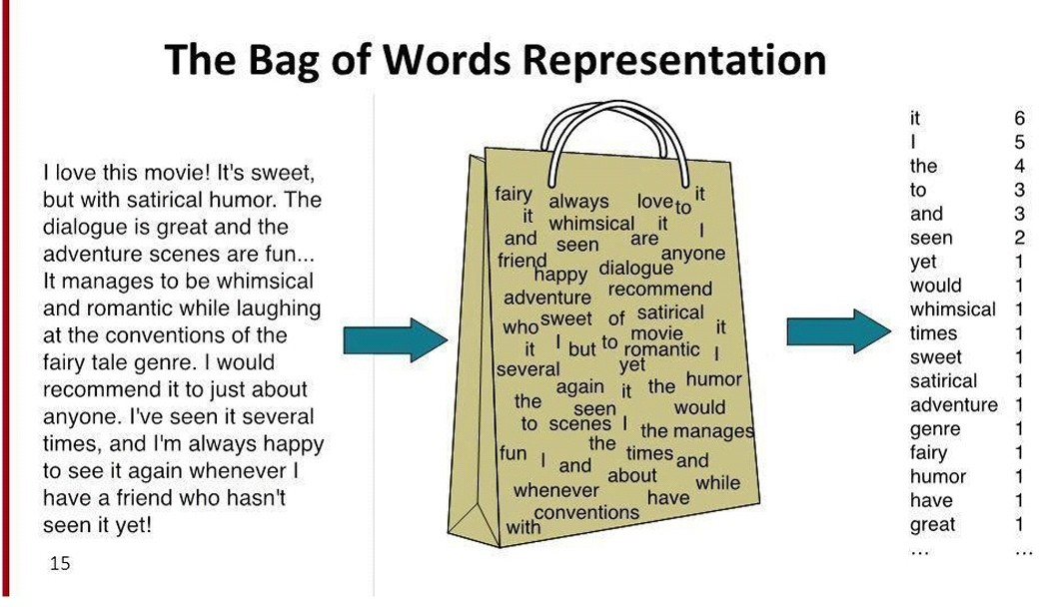

Slide 25
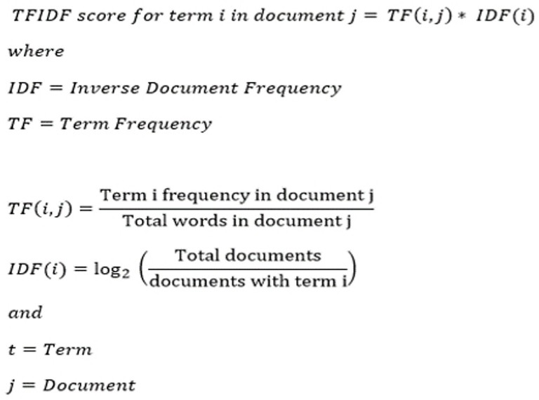
TF-IDF
term frequency­ inverse document frequency
A method used to represent text in a format which can be easily processed by the machine learning algorithms

Slide 26
The TF­IDF weight is composed of 2 terms:
TF (Term Frequency): Term frequency is defined as the frequency of a word in the document. TF is calculated as:
TF (w) = (Number of times word ‘w’ appears in the document)/(Total number of words in the document).
IDF (Inverse Document Frequency): This measures how important a word is in the document. For example, words like and, of, the, a appears lot of times but they are less important. Thus most repeated terms are given less weights and less frequent terms are given more weights.
IDF (w) = loge (Total number of documents / Number of documents with word ‘w’ in it)

Slide 27
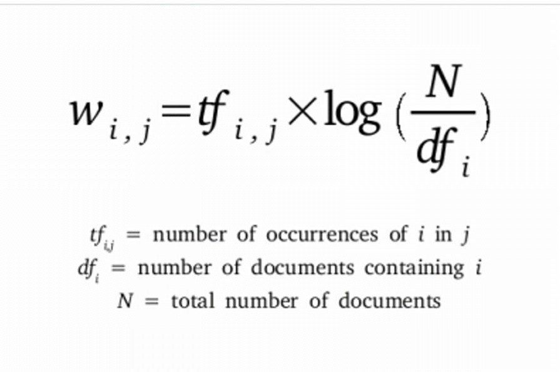

Slide 28
SHALLOW & DEEP SYNTACTICAL ANALYSIS
One of the primary techniques that is used for the understanding of natural language .
Syntactical analysis means analysing natural language with the rule of formal grammar

Slide 29
SEMANTIC ANALYSIS
A widely used open­source resource for incorporating semantic information is Empath
Empath contains lexicons for each semantics
Converted into TFIDF as its frequency
It has 194 semantic categories
Anger, nervousness, negative or positive tones, etc.

Slide 30
EXTRACTING REVIEWS
The API key for twitter and Facebook are both obtained before-hand
The user submit the URL via Web app.
An API selector function analyses the URL and returns appropriate API that needs to be called
http request is used to call appropriate API

Slide 31
On receiving the post request, the twitter/Facebook API server checks for validity of the key
If the key is valid, requested information is returned in the form of an HTTP response
The data is extracted from the response and data preprocessing techniques are applied on it before feeding it into the ML model for prediction.

Slide 32
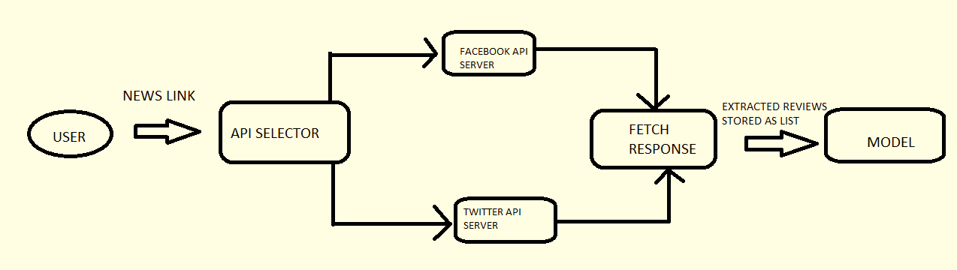

Slide 33

CLASSIFICATION
Classification is used to classify vectors as fake or real.
We aim to use XG boost for our project

Slide 34
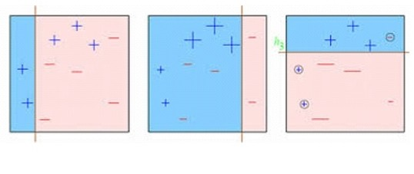
GRADIENT BOOSTING
Gradient boosting is an example of boosting ensemble model.
Boosting is an ensemble technique in which the predictors are not made independently, but sequentially.
Boosting tries to convert a weak learner to become better. It learns from its mistakes/error and tries to reduce the error.

Slide 35
XG BOOST
XG Boost stands for eXtreme Gradient Boosting.
XG boost is a decision tree based ensemble machine learning algorithm that uses gradient boosting framework.
it uses the principle of boosting weak learners using gradient descent algorithm
By combining both the benefits of random forest and gradient boosting, XG Boost reduces prediction error 10 times lower than boosting or random forest

Slide 36
FEATURES
Regularization: This is considered to be as a dominant factor of the algorithm. Regularization is a technique that is used to get rid of overfitting of the model.
Cross-Validation: We use cross-validation by importing the function from sklearn but XGBoost is enabled with inbuilt CV function.
Missing Value: It is designed in such a way that it can handle missing values. It finds out the trends in the missing values and apprehends them.

Slide 37
Flexibility: It gives the support to objective functions. They are the function used to evaluate the performance of the model and also it can handle the user-defined validation metrics.
Save and load: It gives the power to save the data matrix and reload afterwards that saves the resources and time

Slide 38
ADVANTAGES OF USING XGBOOST
Easy to use
- easy to install
- highly developed python interface for users
Efficiency
- Automatic parallel computation on single machine
Accuracy
- Good result for most data sets

Slide 39
TRAINING & TESTING
Creation and collection of data
Pre-processing
Train- Test split
Train data
Save it as a pickle file
High accuracy
Evaluate the model
Train the model
(XG BOOST)
Test data
Low Accuracy
Hyper parameters training
(Grid Search CV
Or
Random Search)

Slide 40
FAKE NEWS DETECTOR
User
Link
Crawl data from the link
Extracting reviews and posts from i/p
Pre-process the data
Predicting the input data
Load the pickle file
REAL
FAKE

Slide 41
html Code for webpage creation
https://github.com/ceccs18c43/Fake-News-Detection/blob/main/home.html

Slide 42
Coding
https://github.com/ceccs18c35/Fake-News-Detector/blob/main/Fake_news_detector.ipynb

Slide 43
SCOPE
Detect fake news using Machine Learning and NLP techniques
Detect fake news in social media in a short period of time
Reduces the spread of fake news relating to health

Slide 44
LIMITATIONS
Detects fake news in Facebook and Twitter only
Does not detect fake news through images
Does not detect fake news in other languages except English
Requires large amount of dataset for training

Slide 45
CONCLUSION
Our project provides an insight into the procedure of detecting fake news, it's implementation and its results . It also helps us to determine the fake news in short period of time and will help us to control the spread of fake news relating to health.

Slide 46
REFERENCES
S. Feng, R. Banerjee, and Y. Choi, “Syntactic stylometry for deception detection,” in Proceedings of the 50th Annual Meeting of the Association for Computational Linguistics: Short Papers ­ Volume 2, ACL ’12, (Stroudsburg, PA,USA), pp. 171– 175, Association for Computational Linguistics, 2012.
N. J. Conroy, V. L. Rubin, and Y. Chen, “Automatic deception detection: Methods for finding fake news ” in Proceedings of the 78th ASIS&T Annual Meeting Information Science with Impact: Research in and for the Community, ASIST’15, (Silver Springs, MD, USA), pp. 82:1–82:4, American Society for Information Science, 2015.
V. Pérez­Rosas, B. Kleinberg, A. Lefevre, and R. Mihalcea, “Automatic detection of fake news,” CoRR, vol. abs/1708.07104, 2017.
S. Gilda, “Evaluating machine learning algorithms for fake news detection,” in 2017 IEEE 15th Student Conference on Research and Development (SCOReD), pp. 110–115, Dec 2017.

Slide 47
THANK YOU

